Slide 1

The Tennis “Big 3”
by Harshal Rukhaiyar and Vaughn Hajra
Graphic via ESPN
Analyzing the Careers of Nadal, Djokovic, and Federer

Slide 2
What Makes a GOAT?
Winning Matches
Being Ranked World #1
Winning Grand Slams

Slide 3
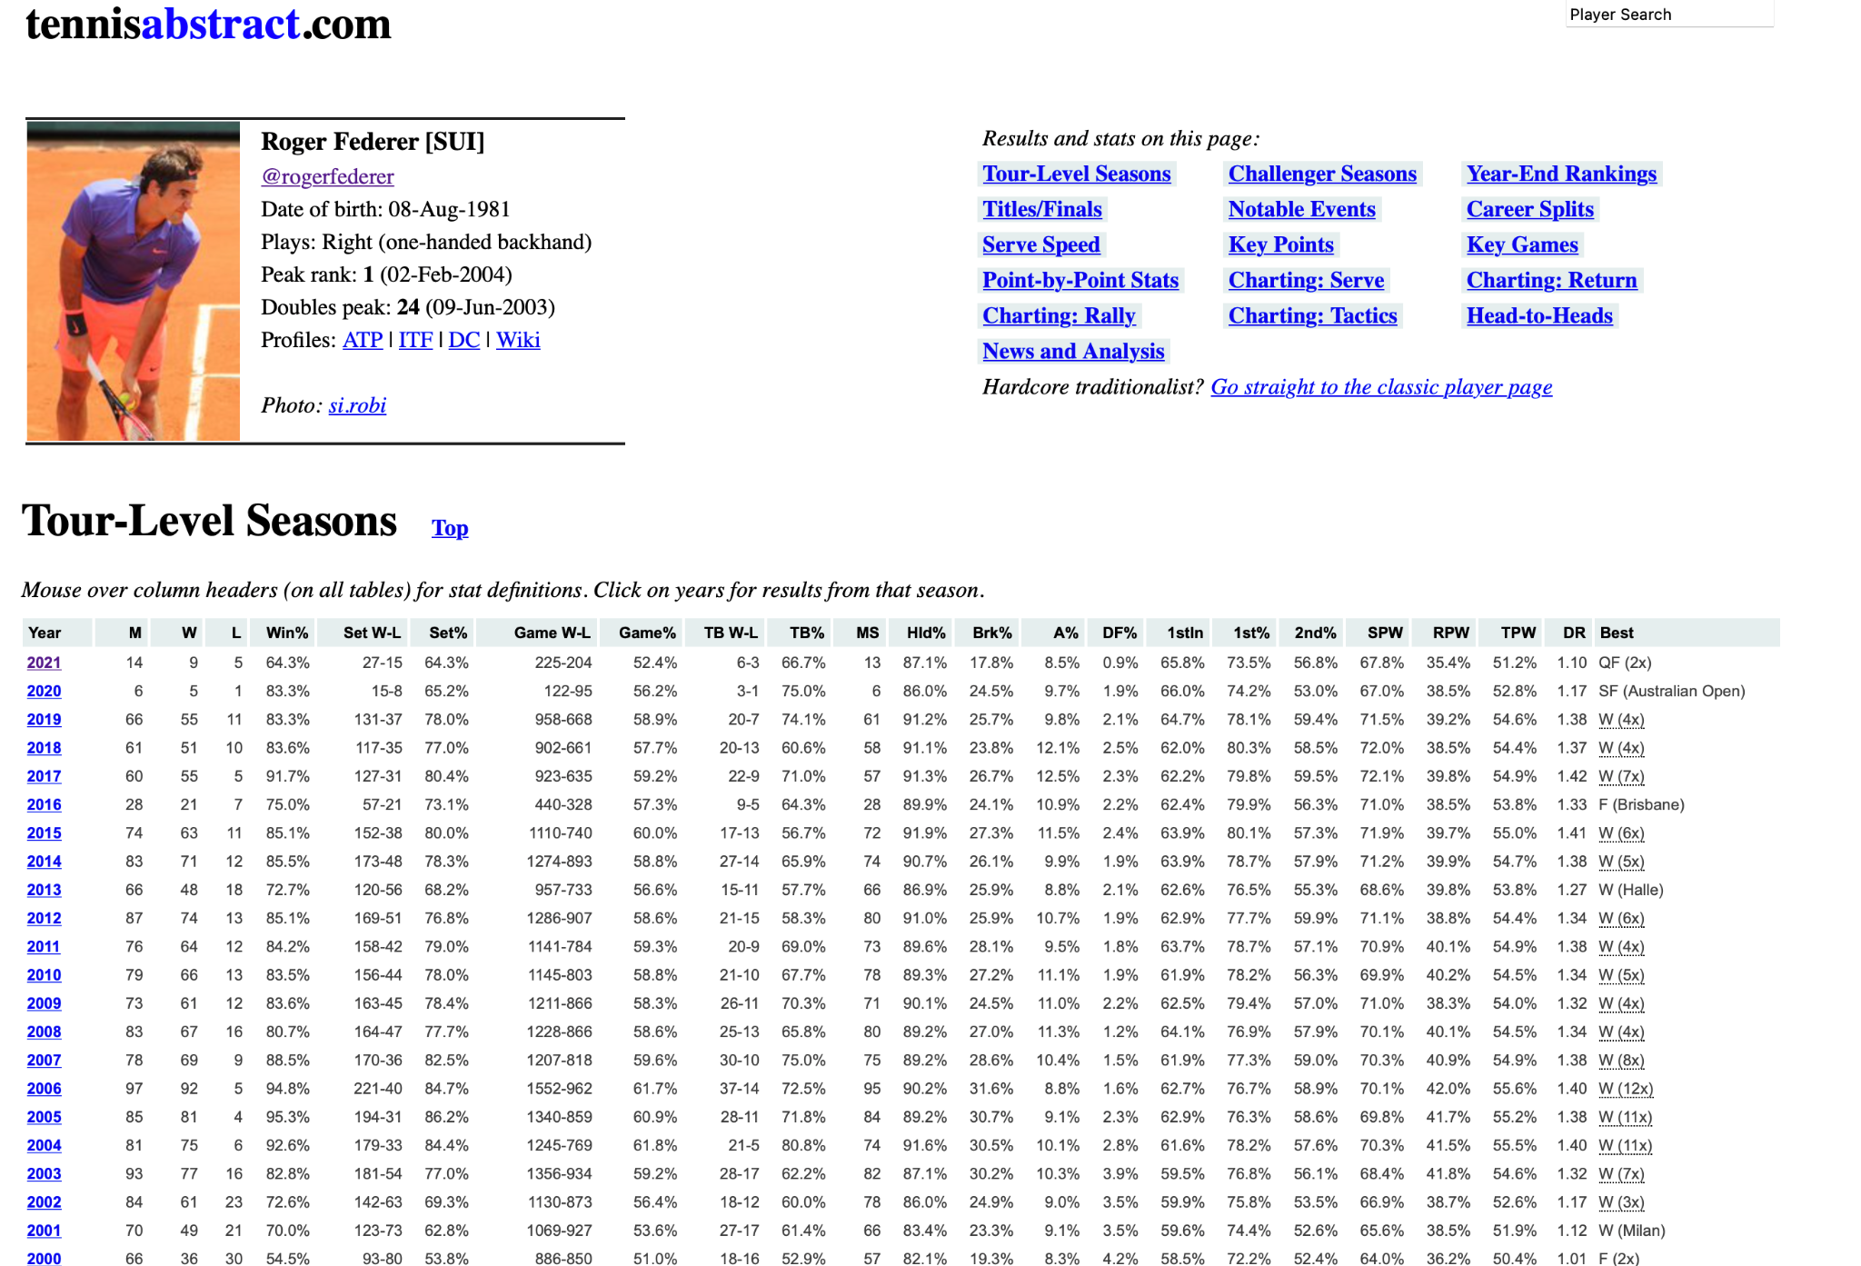
Our Data: via Tennis Abstract
Different Page for Each Player
Many Different Data Sets for Each Page
Example Data Set!

Slide 4
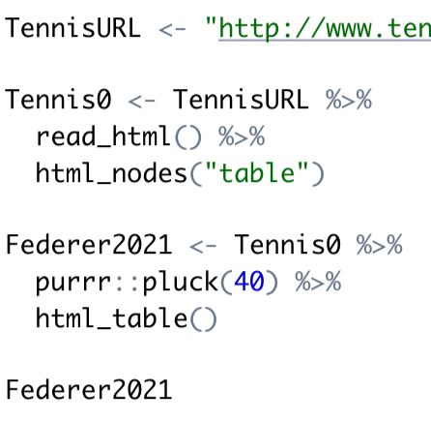
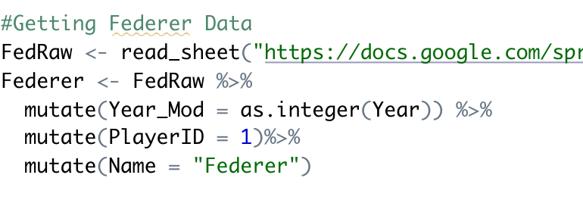
Getting the Data Into R
First tried to use read_html() and pluck() functions → Did not work :(
Used the googlesheets4 package → It worked :)

Slide 5
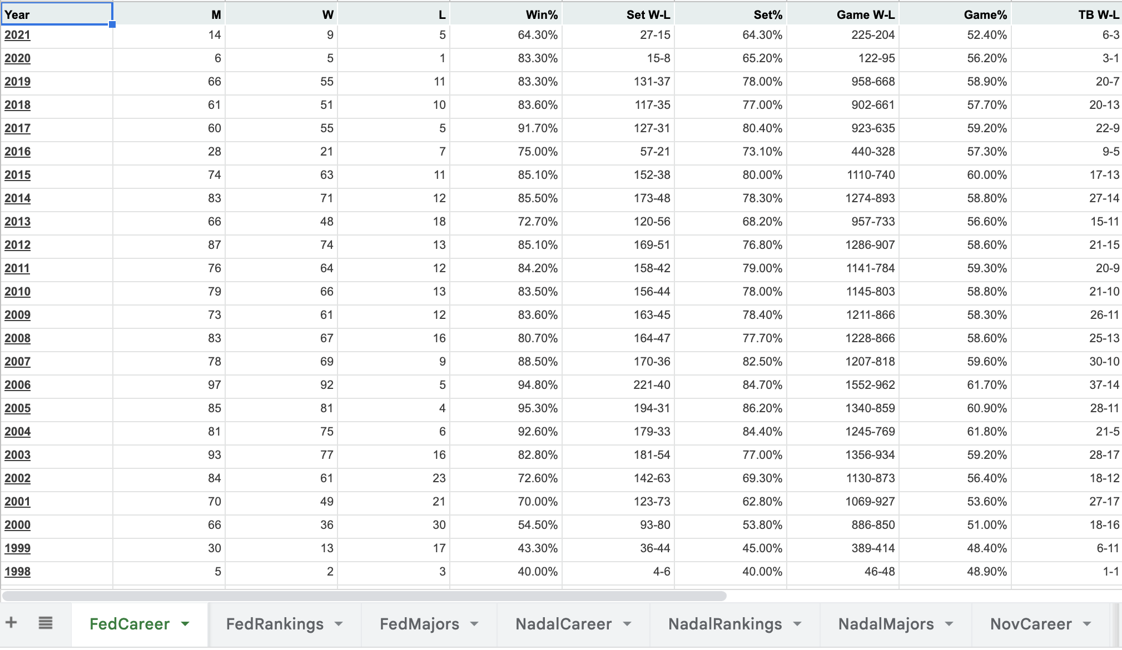
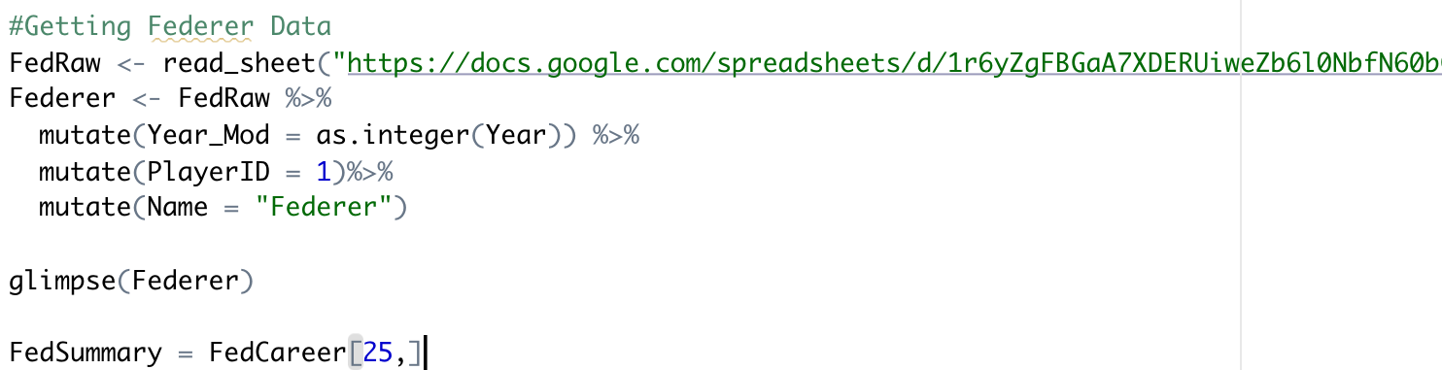
Our Data: In Google Sheets
Our R-code
Table in google sheet

Slide 6
Graph One:
Winning Percentage
Data of Interest:
Career Win/Loss by Year Statistics (one table for each player)
Career Year End Rankings (one table for each player)
Age of each player (birth date found on players’ homepage)
Graph type of interest: Line/dot plot

Slide 7
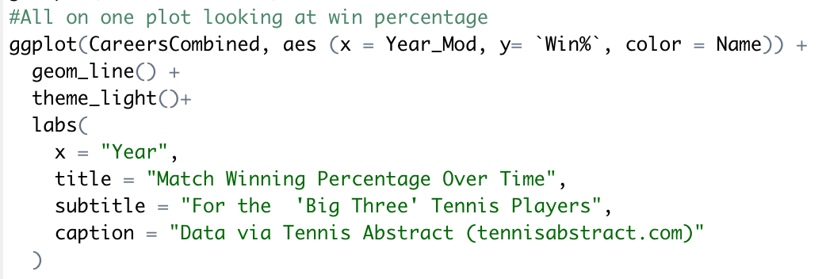
Data Manipulation Explained!
First, we took individual players’ datasets and added PlayerID and (last) Name variables using mutate()
Issue with the Year Variable in dataset, and our solution
Combining multiple datasets (one for each player) into one dataset using rbind()
Used the following code to make the graph:

Slide 8
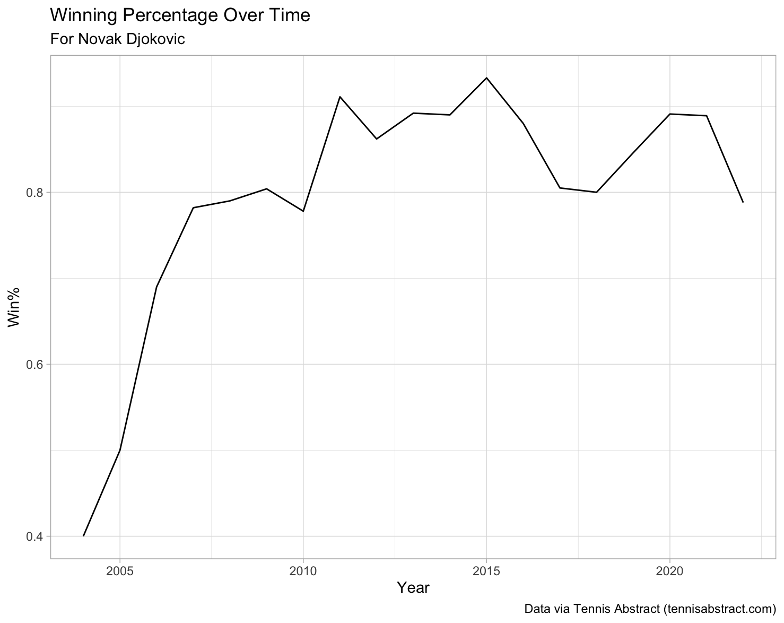
(R Code Line #53)

Slide 9
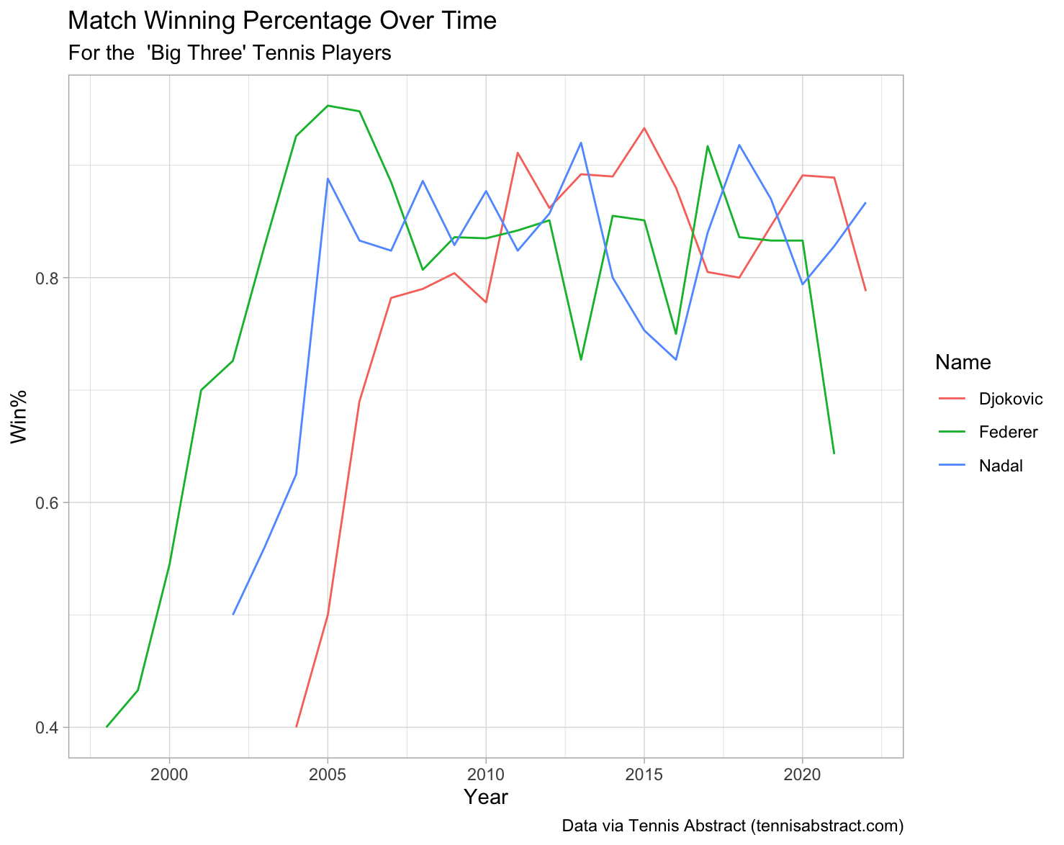
(R Code Line #82)

Slide 10
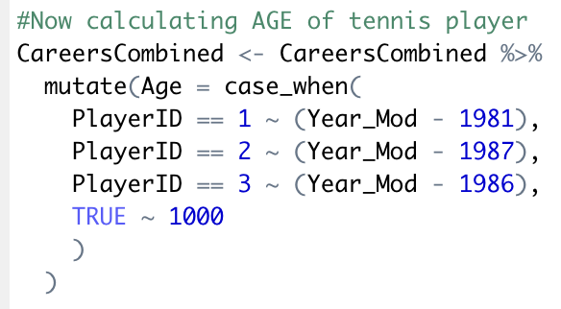
Now, Adjusting for Age
(R Code Line #94)
We liked how the previous graph came out, but also realized a similar trend when entering the pro ranks
We decided to make a new variable, “Age” to compare the players at the same age using case_when() :

Slide 11
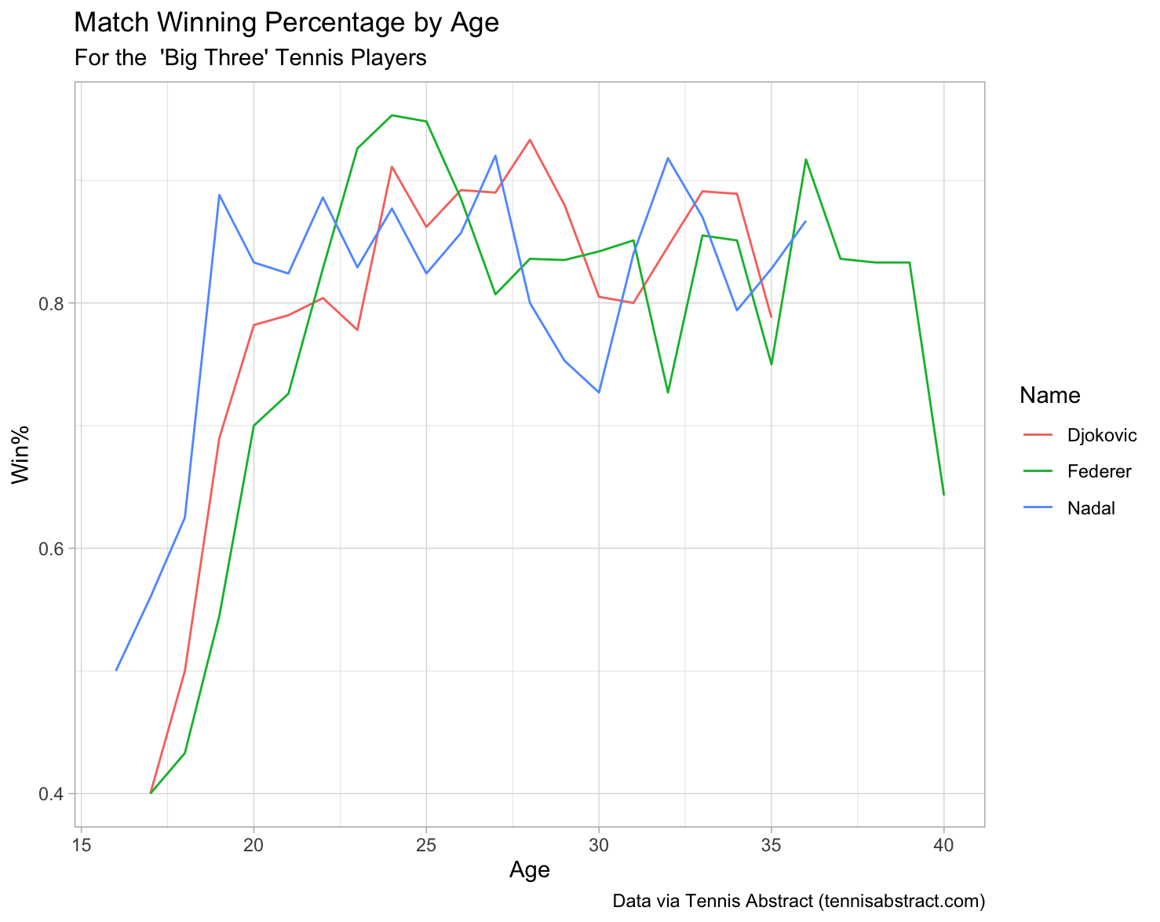
(R Code Line #104)

Slide 12
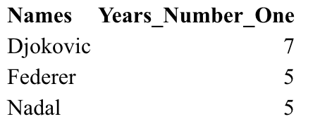
What about Being Ranked #1?
(R Code Line #213)
Imported new dataset for each player “Rankings”
Created Year_Mod variable and used inner_join()
  Then used rbind() to make one large dataset
Also created “Years #1” Table by filtering and using nrow() for each player, then creating a data frame and sorting descending:

Slide 13
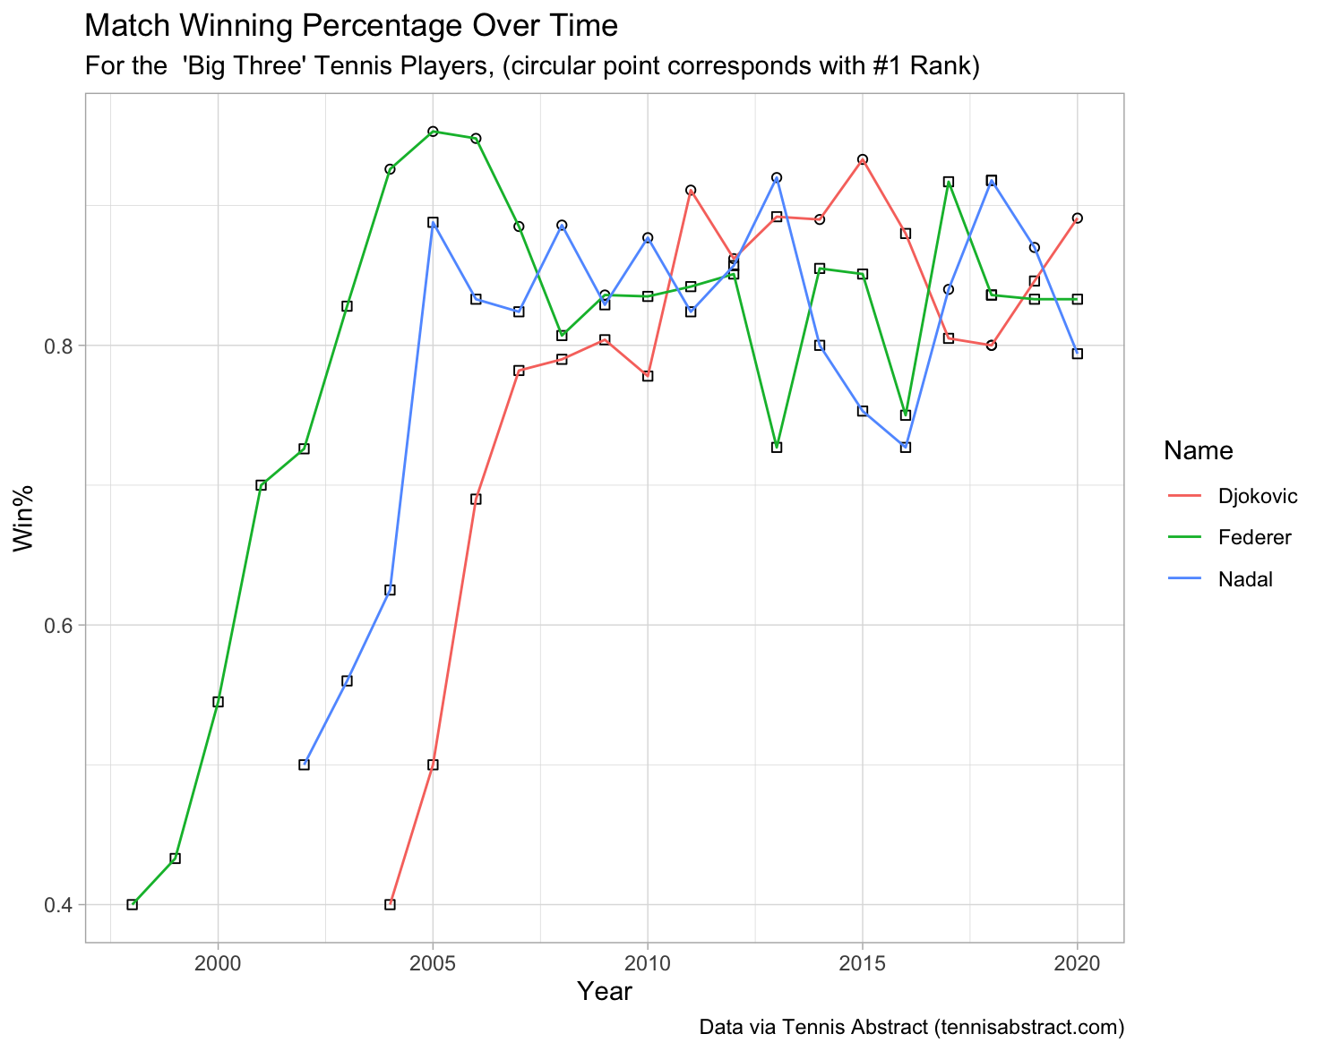
(R Code Line #177)

Slide 14
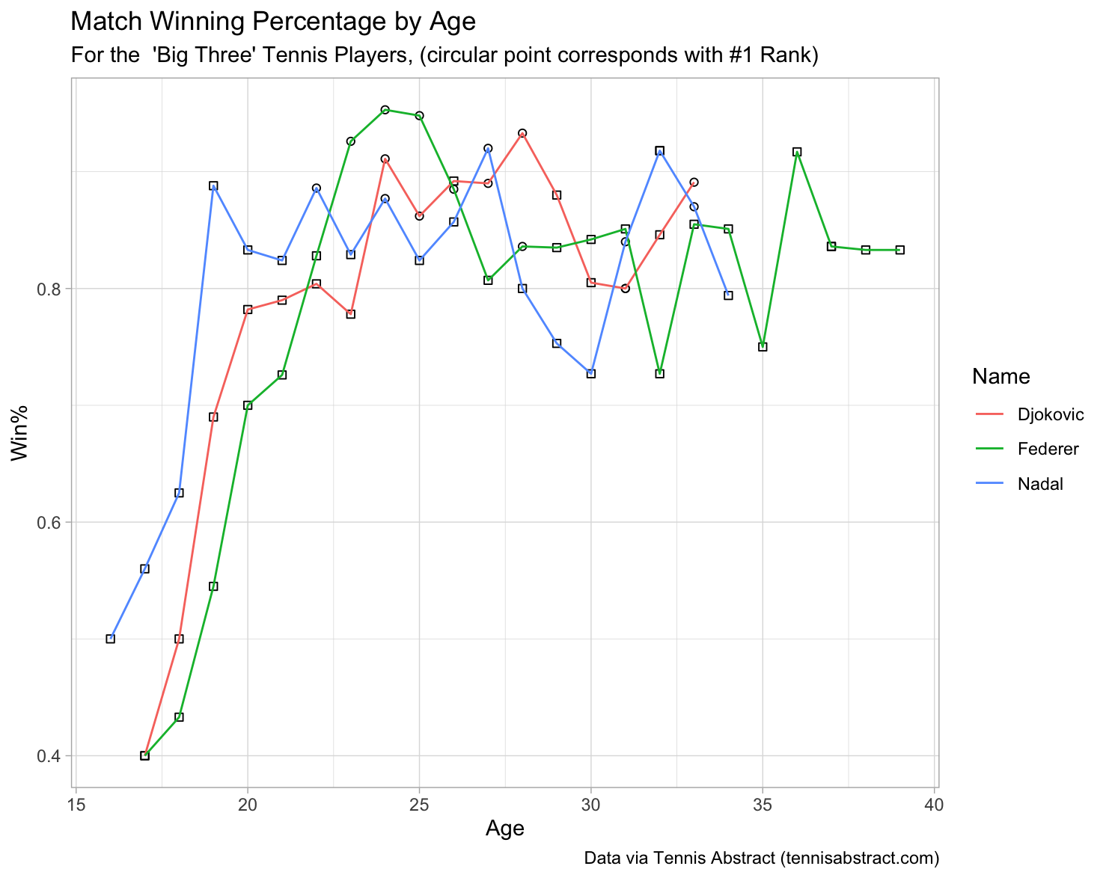
(R Code Line #189)

Slide 15
Graph Two:
Grand Slams
Data of Interest: Career Notable Finals (One for Each Player)
(turning into dataset for stacked bar graph)
Graph type of interest: Stacked Bar Graph

Slide 16
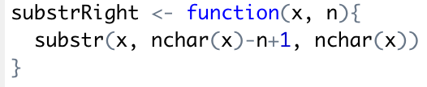
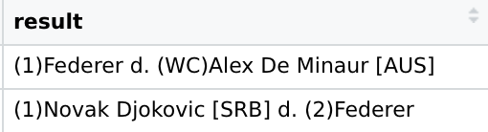
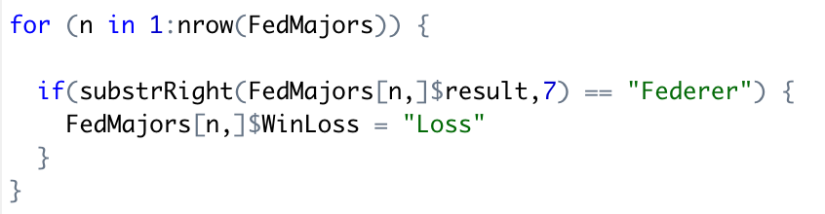
Data Manipulation Explained!
Substr Right function from stack overflow!
https://stackoverflow.com/questions/7963898/extracting-the-last-n-characters-from-a-string-in-r
(R Code Line #244)
We needed to make a new dataframe to create this graph
Took dataset of all major finals, added PlayerID, Name, Result, and WinLoss variables
Filling in WinLoss Variable using match result:

Slide 17
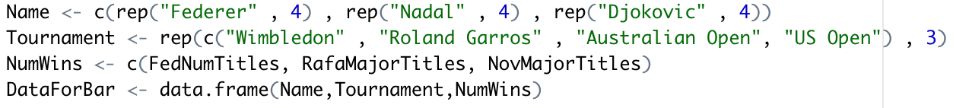
Next, Getting Number of Titles
Dataset Idea via R Graph Gallery!
https://r-graph-gallery.com/48-grouped-barplot-with-ggplot2)
(R Code Line #320)
Filtered MajorWins by grand slams, took the number of wins for each player, and inputted into value for each player
Table of Grand Slam Wins
New dataframe with each player name, the tournament, and the number of titles for each tournament:

Slide 18
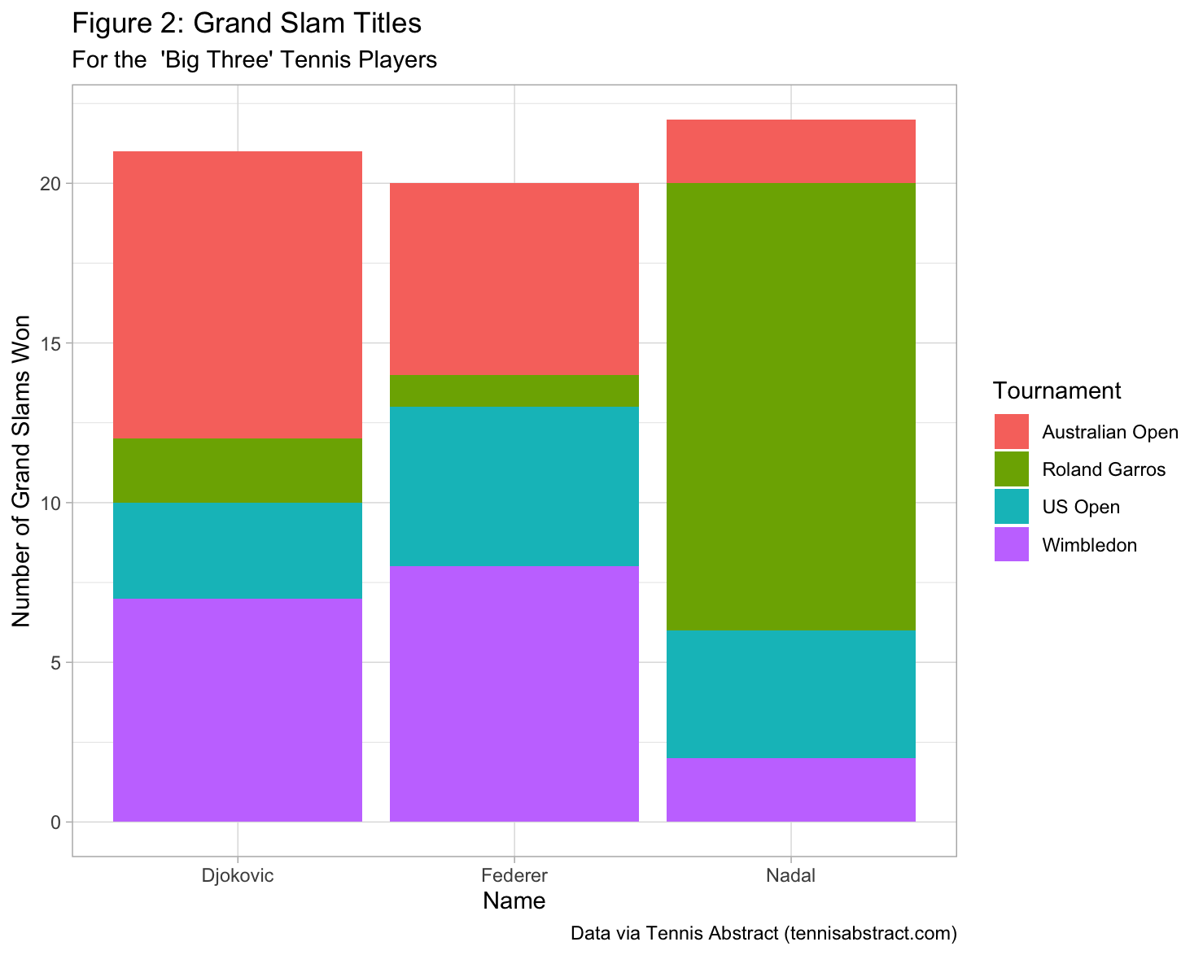
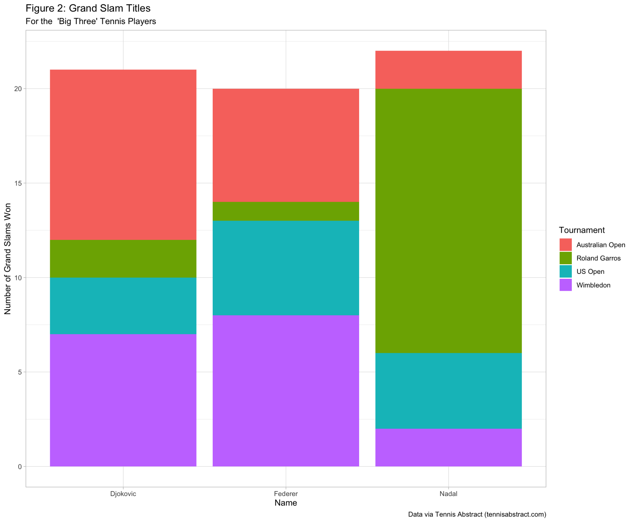
(R Code Line #189)

Slide 19
Recap of Topics Covered
Data Visualization (theme_light, shapes, etc)
Grammar (ggplot, aes, bar graph, etc)
Data Wrangling (mutate, filter, arrange, etc)
Data Wrangling with multiple tables (inner_join, rbind)
Tidy data (googlesheets4, website, etc)
Iteration (for loop)

Slide 20
Other Considerations
Relationship between Aces served and Win%
Relationship between First set won and Win%

Slide 21
Thank You!
Any Questions?

